Slide 1
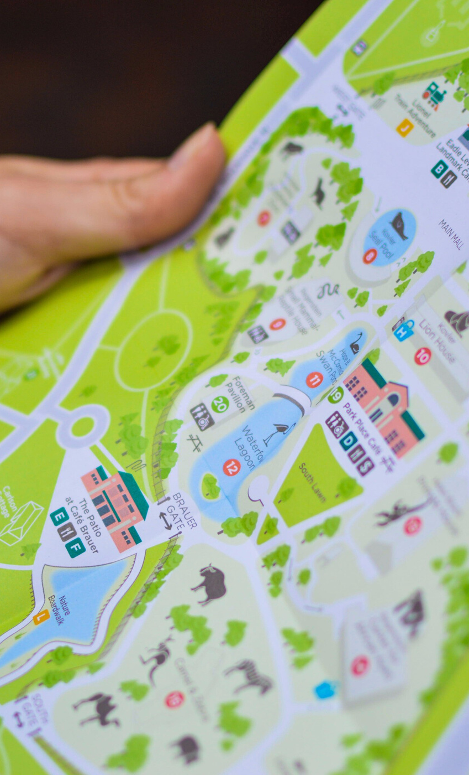


MOVE, BAUSKA!

Slide 2
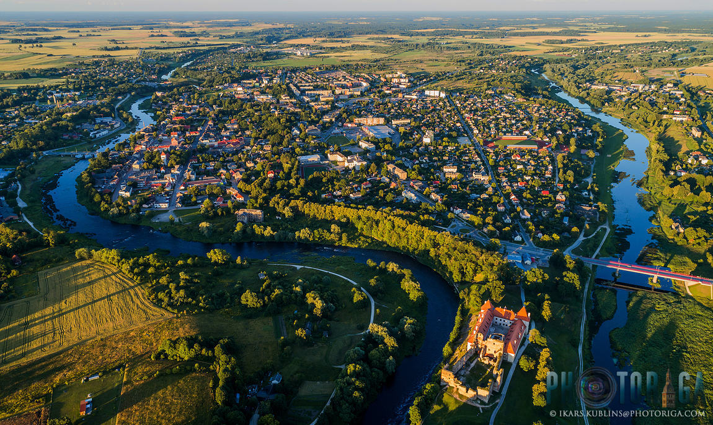
The product
A digitalised walking/cycling route around Bauska. The route has QR codes placed at most popular sightseeing objects/attraction points.

Slide 3

The team
Roberta Zvejniece (Leader, Technical designer)
Annija Vītoliņa (Functional designer)
Kristiāna Jaunpetroviča (Communication)
Emīls Kraģis (Communication)
Sofia Ogorodnikova (Designer)
Rihards Žilionis (Technical designer)
Dilobar Tojiboeva (Information researcher)

Slide 4
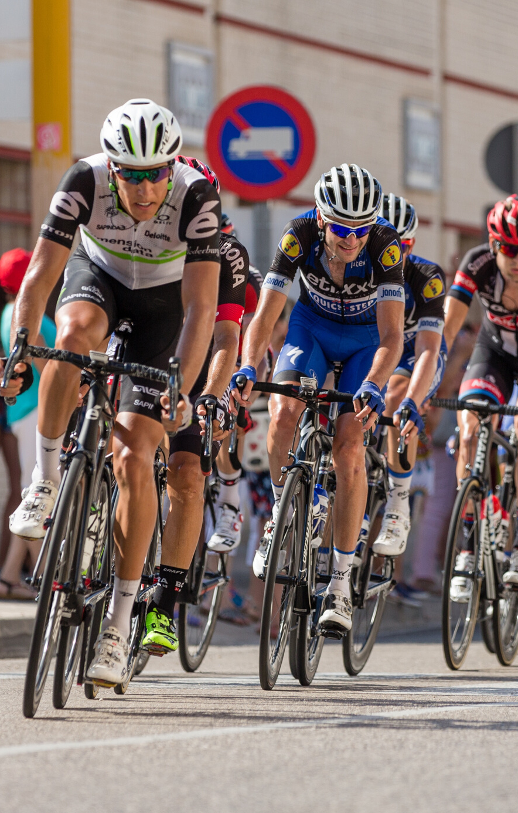
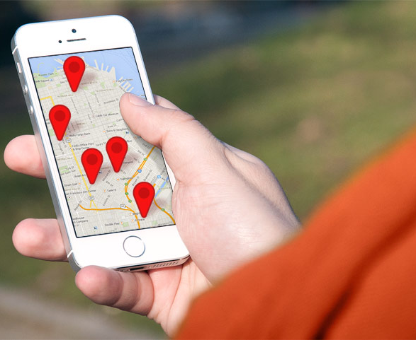
Initial idea
Digitalised sightseeing route
Annual Unity Ride

Slide 5
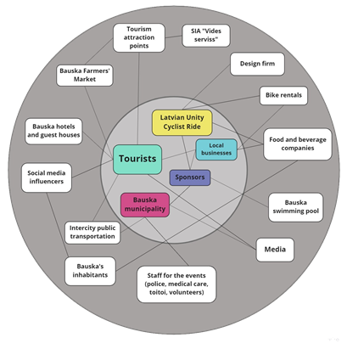
Initial project stakeholders

Slide 6

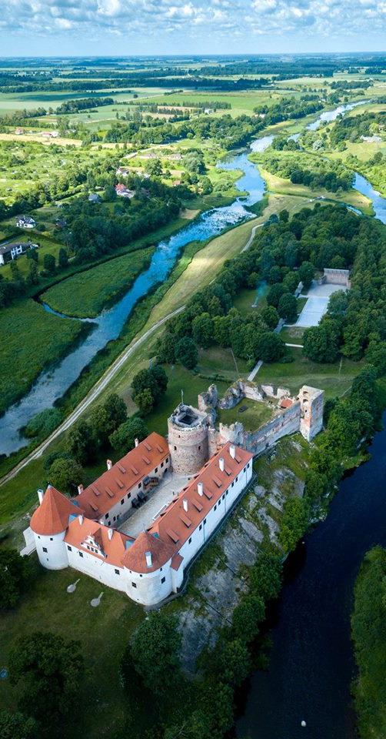
Problem Identification
Research about Bauskas current tourism situation
The growing trend of QR codes
Lack of active tourism

Slide 7

What pivots/ iterations solution testing brought to your product/ service?
Cancelling of the Unity Ride
We changed the idea of a longer route

Slide 8
Solution testing
Collaboration with the Bauska Tourist Information Centre
Implementation of ideas, such as different languages, newest attraction points, and other changes to the prototype

Slide 9
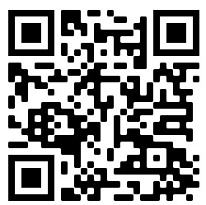
Product at the moment

Slide 10
Future
FEW ADJUSTMENTS NEED TO BE MADE
TAKEOVER BY BAUSKA TOURISM INFORMATION CENTRE

Slide 11
Key lessons learned
A team needs a strong and certain leader
The need of respect and caring within a team
Communication is the key
Be flexible
Before working on an idea, do a deep research on the situation and the problem

Slide 12
Contact Us
emilsss25@gmail.com
kristiana.jaunpetrovica@gmail.com

Slide 13
Thank you!

